Slide 1
Internet Control Message Protocol
Objectives
Upon completion you will be able to:
Be familiar with the ICMP message format
Know the types of error reporting messages
Know the types of query messages
Be able to calculate the ICMP checksum
Know how to use the ping and traceroute commands
Understand the modules and interactions of an ICMP package

Slide 2
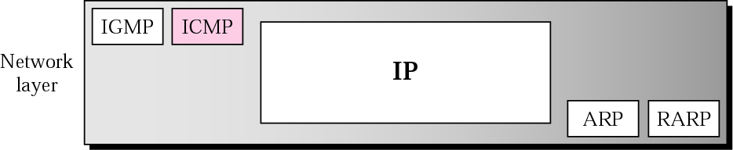
Position of ICMP in the network layer
IP has no error-reporting or error-correcting mechanism
IP protocol also lacks a mechanism for host and management queries.
ICMP ( Internet Control Message Protocol) has been designed to compensate for the above two deficiencies.
The Position of ICMP in the network layer is shown below.
Notes:
Router can’t find the final destination on its routing table or TTL has zero value. Discard all fragments because all fragments did not reach within predetermined time limit.
Station is active or not ; 1 host might require info from another host/router – management.

Slide 3
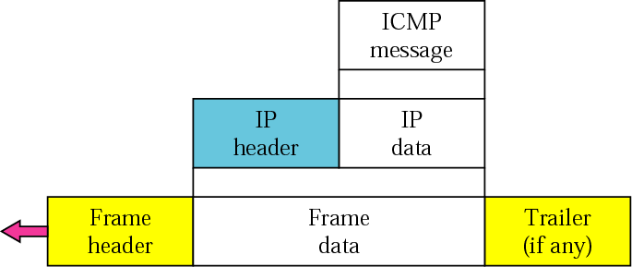
ICMP encapsulation
ICMP Messages are encapsulated in the IP Datagram

Slide 4
TYPES OF MESSAGES
ICMP messages are divided into
error-reporting messages and
query messages.
The error-reporting messages report problems that a router or a host (destination) may encounter.
The query messages get specific information from a router or another host.
Notes:
Protocol value is 1 in

Slide 5
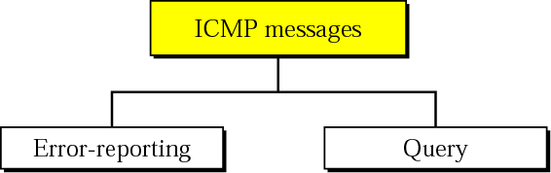
ICMP messages
ICMP does not correct errors, it simply reports them
ICMP always reports error messages to the original source.
Error Correction is left to higher level protocols.
Notes:
ICMP does not correct errors, it simply reports
them. Error correction is left to the higher-level protocols. Error messages are always
sent to the original source because the only information available in the datagram about
the route is the source and destination IP addresses. ICMP uses the source IP address to
send the error message to the source (originator) of the datagram.

Slide 6
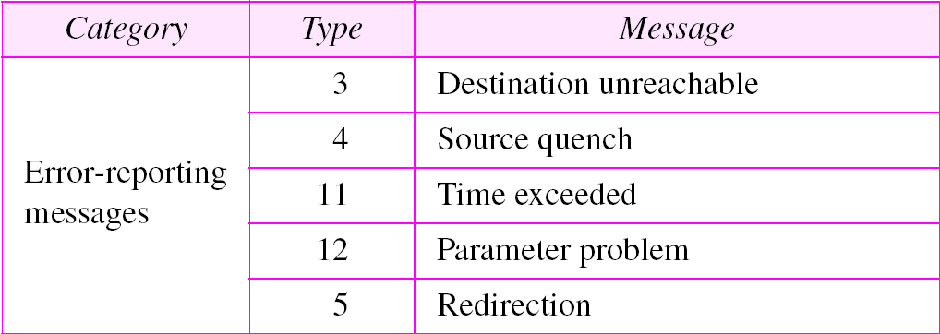
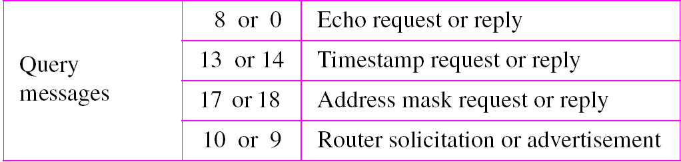
ICMP messages

Slide 7
MESSAGE FORMAT
An ICMP message has an 8-byte header and a variable-size data section. Although the general format of the header is different for each message type, the first 4 bytes are common to all.

Slide 8
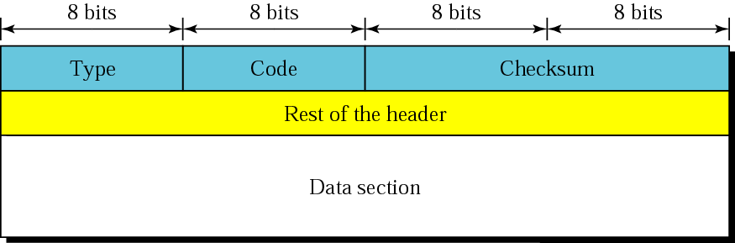
General format of ICMP messages
Data section of the ICMP, carries information for finding the original packet that had the error.
Query msg, the data section carries extra information based in the type of the query.
Notes:
Data section of the ICMP, carries information for finding the original packet that had the error.
In query msg, the data section carries extra information based in the type of the query.

Slide 9
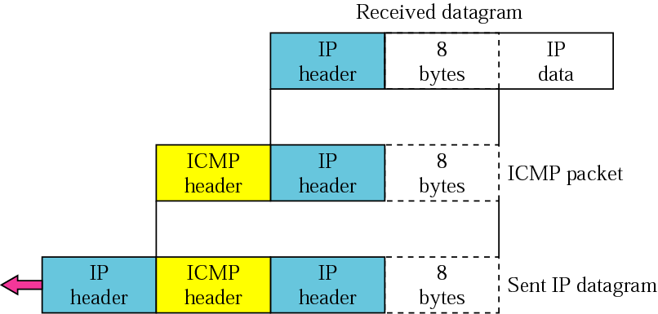
Contents of data field for the error messages
IP header of the original datagram which gives IP header information of the source to whom error report is to be sent
8 bytes of data in the original datagram which includes information such as port addresses, SYN no(TCP) etc.
Notes:
Note that all error messages contain a data section that includes the IP header of
the original datagram plus the first 8 bytes of data in that datagram. The original datagram
header is added to give the original source, which receives the error message,
information about the datagram itself. The 8 bytes of data are included because, as we
will see in Chapters 14 and 15 on UDP and TCP protocols, the first 8 bytes provide
information about the port numbers (UDP and TCP) and sequence number (TCP). This
information is needed so the source can inform the protocols (TCP or UDP) about the
error. ICMP forms an error packet, which is then encapsulated in an IP datagram

Slide 10
ERROR REPORTING
IP, as an unreliable protocol, is not concerned with error checking and error control. ICMP was designed, in part, to compensate for this shortcoming. ICMP does not correct errors, it simply reports them.
The topics discussed in this section include:
Destination Unreachable
Source Quench
Time Exceeded
Parameter Problem
Redirection

Slide 11
Note:
ICMP always reports error messages to the original source but does not correct errors.
Error Messages are always sent to the original source because this is the only information available in the datagram

Slide 12
Note:
The following are important points about ICMP error messages:
❏ No ICMP error message will be generated in response to a datagram carrying an ICMP error message. ❏ No ICMP error message will be generated for a fragmented datagram that is not the first fragment. ❏ No ICMP error message will be generated for a datagram having a multicast address. ❏ No ICMP error message will be generated for a datagram having a special address such as 127.0.0.0 or 0.0.0.0.

Slide 13
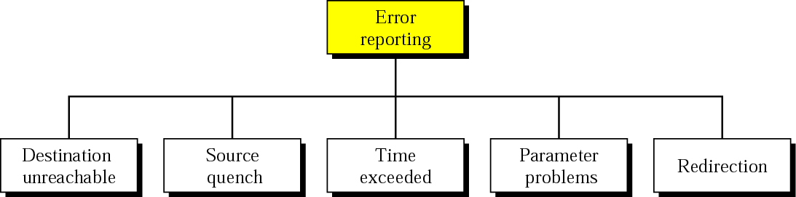
Error-reporting messages

Slide 14
Destination Unreachable
When a router cannot route a datagram or a host cannot deliver a datagram, the datagram is discarded and the router or the host sends a destination-unreachable message back to the source host that initiated the datagram

Slide 15
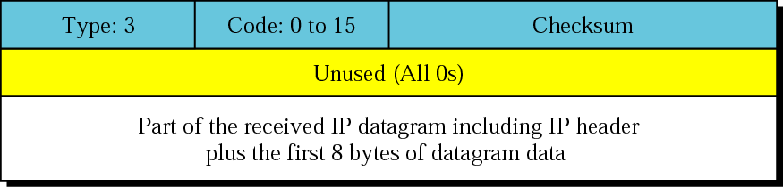
Destination-unreachable format

Slide 16
Code 0. The network is unreachable, possibly due to hardware failure.
Code 1. The host is unreachable. This can also be due to hardware failure.
Code 2. The protocol is unreachable. An IP datagram can carry data belonging to higher-level protocols such as UDP, TCP, and OSPF
Code 3. The port is unreachable. The application program (process) that the datagram is destined for is not running at the moment.
Code 4. Fragmentation is required, but the DF (do not fragment) field of the datagram has been set. In other words, the sender of the datagram has specified that the datagram not be fragmented, but routing is impossible without fragmentation.
Code 5. Source routing cannot be accomplished. In other words, one or more routers defined in the source routing option cannot be visited.
Code 6. The destination network is unknown.
Code 7. The destination host is unknown.

Slide 17
Code 8. The source host is isolated.
Code 9. Communication with the destination network is administratively prohibited.
Code 10. Communication with the destination host is administratively prohibited.
Code 11. The network is unreachable for the specified type of service. This is different from code 0. Here the router can route the datagram if the source had requested an available type of service.
Code 12. The host is unreachable for the specified type of service. This is different from code 1. Here the router can route the datagram if the source had requested an available type of service.
Code 13. The host is unreachable because the administrator has put a filter on it.
Code 14. The host is unreachable because the host precedence is violated. The message is sent by a router to indicate that the requested precedence is not permitted for the destination.
Code 15. The host is unreachable because its precedence was cut off.

Slide 18
Note:
Destination-unreachable messages with codes 2 or 3 can be created only by the destination host.
Other destination-unreachable messages can be created only by routers.
Notes:
Code 2. The protocol is unreachable. An IP datagram can carry data belonging to higher-level protocols such as UDP, TCP, and OSPF
Code 3. The port is unreachable. The application program (process) that the datagram is destined for is not running at the moment.

Slide 19
Note:
Even if a router does not report a destination unreachable message, it does not necessarily mean that the datagram has been delivered.
A router cannot detect all problems that prevent the delivery of a packet.
Notes:
Note that even if a router does not report a destination-unreachable message, it
does not necessarily mean that the datagram has been delivered. For example, if a datagram
is traveling through an Ethernet network, there is no way that a router knows that
the datagram has been delivered to the destination host or the next router because
Ethernet does not provide any acknowledgment mechanism.

Slide 20
Source Quench
There is no flow-control mechanism in the IP protocol.
The source-quench message in ICMP was designed to add a kind of flow control and congestion control to the IP.
When a router or host discards a datagram due to congestion, it sends a source-quench message to the sender of the datagram.
This message has two purposes.
First, it informs the source that the datagram has been discarded.
Second, it warns the source that there is congestion somewhere in the path and that the source should slow down (quench) the sending process.
Notes:
Quench-Put off or extinguish

Slide 21
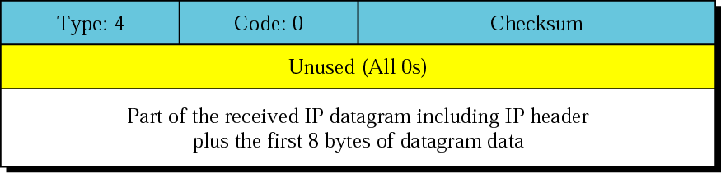
Source-quench format

Slide 22
Note:
A source-quench message informs the source that a datagram has been discarded due to congestion in a router or the destination host.
The source must slow down the sending of datagrams until the congestion is relieved.

Slide 23
Note:
One source-quench message is sent for each datagram that is discarded due to congestion.
Notes:
First, the router or destination
host that has experienced the congestion sends one source-quench message for
each discarded datagram to the source host. Second, there is no mechanism to tell the
source that the congestion has been relieved and the source can resume sending datagrams
at its previous rate. The source continues to lower the rate until no more
source-quench messages are received. Third, the congestion can be created either by
a one-to-one or many-to-one communication. In a one-to-one communication, a single
high-speed host could create datagrams faster than a router or the destination host
can handle. In this case, source-quench messages can be helpful. They tell the source
to slow down. In a many-to-one communication, many sources create datagrams that
must be handled by a router or the destination host. In this case, each source can be
sending datagrams at different speeds, some of them at a low rate, others at a high
rate. Here, the source-quench message may not be very useful. The router or the destination
host has no clue which source is responsible for the congestion. It may drop
a datagram from a very slow source instead of dropping the datagram from the source
that has actually created the congestion.

Slide 24
Time Exceeded
Note:
0. Whenever a router decrements a datagram with a time-to-live value to zero, it discards the datagram and sends a time-exceeded message to the original source.

Slide 25
Note:
1.When the final destination does not receive all of the fragments in a set time, it discards the received fragments and sends a time-exceeded message to the original source.
Notes:
*

Slide 26
Note:
In a time-exceeded message, Code 0 is used only by routers to show that the value of the time-to-live field is zero.
Code 1 is used only by the destination host to show that not all of the fragments have arrived within a set time.

Slide 27

Time-exceeded message format

Slide 28
Parameter-problem
Note:
A parameter-problem message can be created by a router or the destination host.
Notes:
Any ambiguity in the header part of a datagram can create serious problems as the datagram
travels through the Internet. If a router or the destination host discovers an ambiguous
or missing value in any field of the datagram, it discards the datagram and sends a
parameter-problem message back to the source.

Slide 29
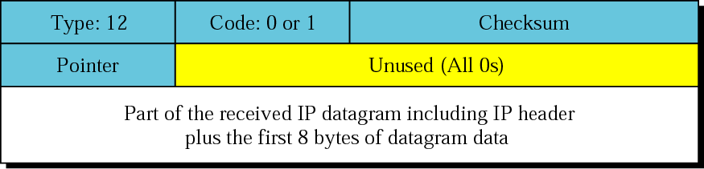
Parameter-problem message format
The code field in this case specifies the reason for discarding the datagram:
Code 0. There is an error or ambiguity in one of the header. In this case, the value in the pointer field points to the byte with the problem. For example, if the value is zero, then the first byte is not a valid field.
Code 1. The required part of an option is missing. In this case, the pointer is not used.
Notes:
Code is 1 pointer is not used. Code is 0 pointer is pointed to the byte with the problem.
Pointer Indicates the Error
This error means that there is a specific problem with the datagram’s structure
(such as a malformed header field). The location of the bad data is provided
in the ICMP Message Data field of the Parameter Problem error message,
allowing the sender to determine the cause of the failure.
Parameter Problem errors almost always result from an incorrect usage of an IP
option. For example, a device may have sent an IP datagram with a malformed
Source Route option in the IP header.
Required Option Is Missing
This error means that a required IP option has not been defined. This message
is used only with the Security options, which are used only by the U.S.
military, and are therefore not discussed in this book.

Slide 30
Redirection
Note:
A host usually starts with a small routing table that is gradually augmented and updated. One of the tools to accomplish this is the redirection message.

Slide 31
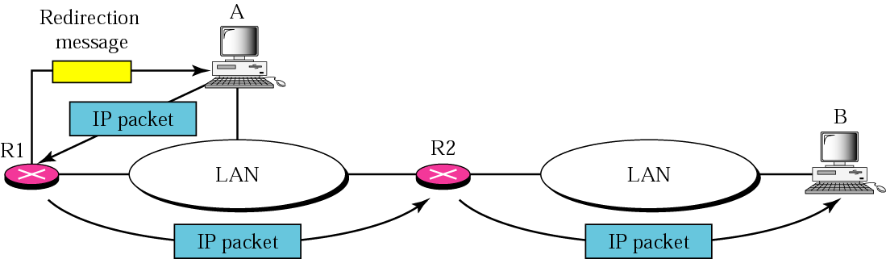
Redirection concept

Slide 32
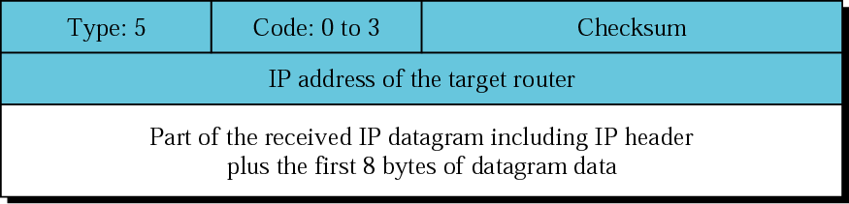
Redirection message format

Slide 33
Code 0. Redirection for a network-specific route.
Code 1. Redirection for a host-specific route.
Code 2. Redirection for a network-specific route based on a specified type of service.
Code 3. Redirection for a host-specific route based on a specified type of service.

Slide 34
Note:
A redirection message is sent from a router to a host on the same local network.

Slide 35
CHECKSUM
In ICMP the checksum is calculated over the entire message (header and data).
The topics discussed in this section include:
Checksum Calculation
Checksum Testing

Slide 36
Example 1
Figure 9.19 shows an example of checksum calculation for a simple echo-request message (see Figure 9.14). We randomly chose the identifier to be 1 and the sequence number to be 9. The message is divided into 16-bit (2-byte) words. The words are added together and the sum is complemented. Now the sender can put this value in the checksum field.
See Next Slide

Slide 37
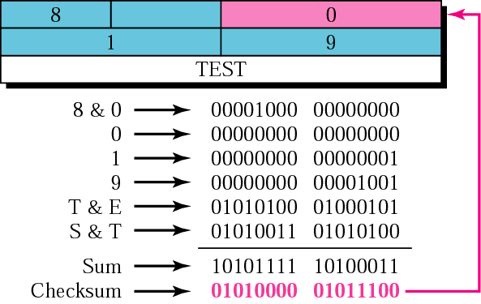
Figure 9.19 Example of checksum calculation

Slide 38
QUERY
ICMP can also diagnose some network problems through the query messages, a group of four different pairs of messages. In this type of ICMP message, a node sends a message that is answered in a specific format by the destination node.
The topics discussed in this section include:
Echo Request and Reply
Timestamp Request and Reply
Address-Mask Request and Reply
Router Solicitation and Advertisement

Slide 39
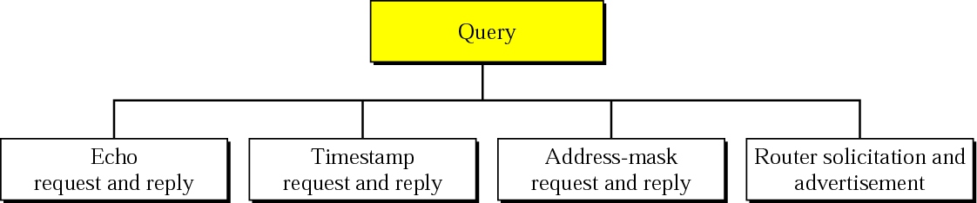
Query messages
Notes:
Information request and replay

Slide 40
Echo Request and Echo Reply
The echo-request and echo-reply messages are designed for diagnostic purposes.
Network managers and users utilize this pair of messages to identify network problems.
The combination of echo-request and echo-reply messages determines whether two systems (hosts or routers) can communicate with each other.

Slide 41
Note:
An echo-request message can be sent by a host or router. An echo-reply message is sent by the host or router which receives an echo-request message.

Slide 42
Note:
Echo-request and echo-reply messages can be used by network managers to check the operation of the IP protocol.

Slide 43
Note:
Echo-request and echo-reply messages can test the reachability of a host. This is usually done by invoking the ping command.

Slide 44
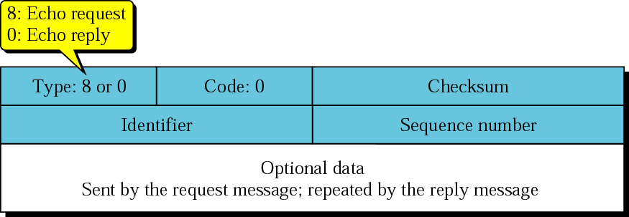
Echo-request and echo-reply messages
Notes:
Identifier and sequence number are not formally defined by the protocol.

Slide 45
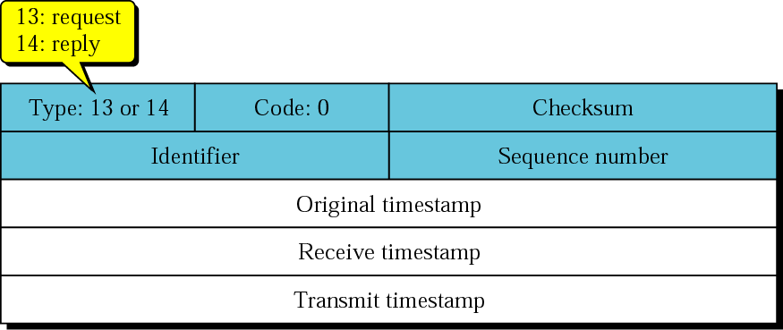
Timestamp-request and timestamp-reply
Timestamp-request and timestamp-reply message format
Each field can hold a number representing
time measured in milliseconds from midnight in Universal Time
Notes:
The identifier and sequence number fields are not formally defined by the protocol and can be used arbitrarily by the sender.
source creates a timestamp-request message
The source fills the original timestamp - its clock at request message departure time
The destination creates the timestamp-reply message
fills the receive timestamp field
the receive timestamp field-clock at the time the request was received.
the transmit timestamp field- clock at the time the reply message departs.

Slide 46
Note:
Timestamp-request and timestamp-reply messages can be used to calculate the round-trip time(RTT) between a source and a destination machine even if their clocks are not synchronized.

Slide 47
The timestamp-request and timestamp-reply messages can be used to compute the one-way or round-trip time required for a datagram to go from a source to a destination and then back again. The formulas are
sending time = receive timestamp − original timestamp
receiving time = returned time − transmit timestamp
round-trip time = sending time + receiving time
original timestamp - its clock at request message departure time
the receive timestamp field-clock at the time the request was received.
the transmit timestamp field- clock at the time the reply message departs.

Slide 48
Note that the sending and receiving time calculations are accurate only if the two clocks in the source and destination machines are synchronized.
However, the round-trip calculation is correct even if the two clocks are not synchronized because each clock contributes twice to the round-trip calculation, thus canceling any difference in synchronization.

Slide 49
Note:
The timestamp-request and timestamp-reply messages can be used to synchronize two clocks in two machines if the exact one-way time duration is known.

Slide 50
Given the actual one-way time, the timestamp-request and timestamp-reply messages can also be used to synchronize the clocks in two machines using the following formula:
Time difference = receive timestamp − (original timestamp field + one-way time duration)
Notes:
A B
Clock clock
10.00 10.02
<-----one way message travel time=3--->
original timestamp receive timestamp
10.00 10.05
Return Time transmit timestamp
10.10 10.07 (assume 10.05+2 min processing)
Receive Timestamp= original timestamp + one way message travel time(+or-)time difference
Receive Timestamp – (original timestamp + one way message travel time)= time difference
time difference= Receive Timestamp – (original timestamp + one way message travel time)
time difference is +ve means , Clock of replier system is Ahead of Clock of Request sender System
time difference is -ve means , Clock of replier system is Lag behind compared to clock of Request sender system

Slide 51
For example, given the following information:
original timestamp: 46
receive timestamp: 59
transmit timestamp: 60
return time: 67
sending time = 59 − 46 = 13 milliseconds
receiving time = 67 − 60 = 7 milliseconds
round-trip time = 13 + 7= 20 milliseconds
Time difference = 59 − (46 + 10) = 3
Notes:
Time difference = receive timestamp − (original timestamp field + one-way time duration)
Clock of reply sender is 3 millisecond ahead compared to Clock of Request Sender System

Slide 52
Example
A computer receives a timestamp request from another computer at 2:34:20 P.M. The value of the original timestamp is 52,453,000. If the sender clock is 5 ms slow, what is the one-way time?

Slide 53
To convert 2:34:20 P.M into milliseconds = 14 x 60 x 60 + 34 x 60 + 20 = 52460000 ms
Original time stamp is 52,453,000.
Receive time stamp is 52,460,000
sender clock is 5 ms slow compared to receiver
Time difference = 5 ms
Time difference = receive timestamp − (original timestamp field + one-way time duration)
5 = 52460000 – 52453000 – one way time duration
One way time duration = 7000 - 5 = 6995 ms.

Slide 54
A computer sends a timestamp request to another computer. It receives the corresponding timestamp reply at 3:46:07 A.M. The values of the original timestamp, receive timestamp, and transmit timestamp are 13,560,000, 13,562,000, and 13,564,300, respectively. What is the sending trip time? What is the receiving trip time? What is the round-trip time? What is the difference between the sender clock and the receiver clock?

Slide 55
Address mask request and reply & Router solicitation and advertisement
Deprecated Messages
Three pairs of messages are declared obsolete by IETF:
Information request and reply
Address mask request and reply messages are not used today because their duties are done by Dynamic Host Configuration Protocol (DHCP)
Router solicitation and advertisement messages are not used today because their duties are done by Dynamic Host Configuration Protocol (DHCP.

Slide 56
ICMP PACKAGE
To give an idea of how ICMP can handle the sending and receiving of ICMP messages, we present our version of an ICMP package made of two modules: an input module and an output module.
The topics discussed in this section include:
Input Module
Output Module

Slide 57
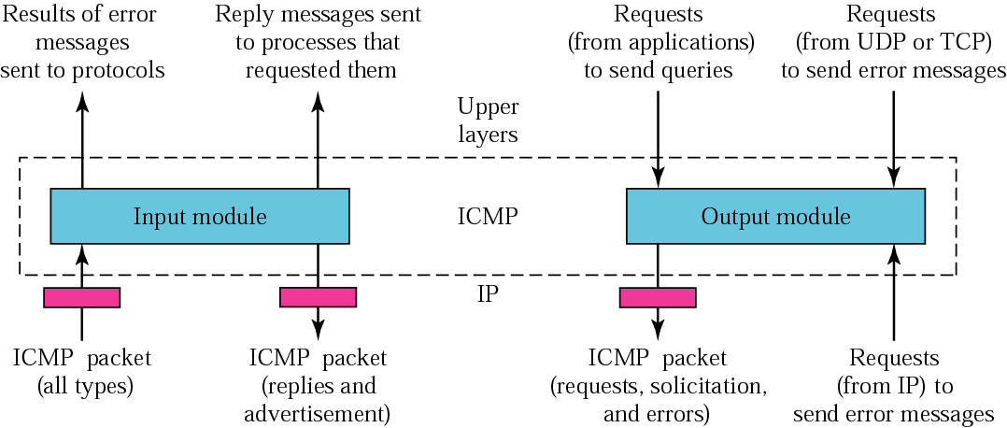
ICMP package
Notes:
IM – type is request create reply ; type is redirection modify routing table; type is error inform appropriate source protocol.

